Slide 1
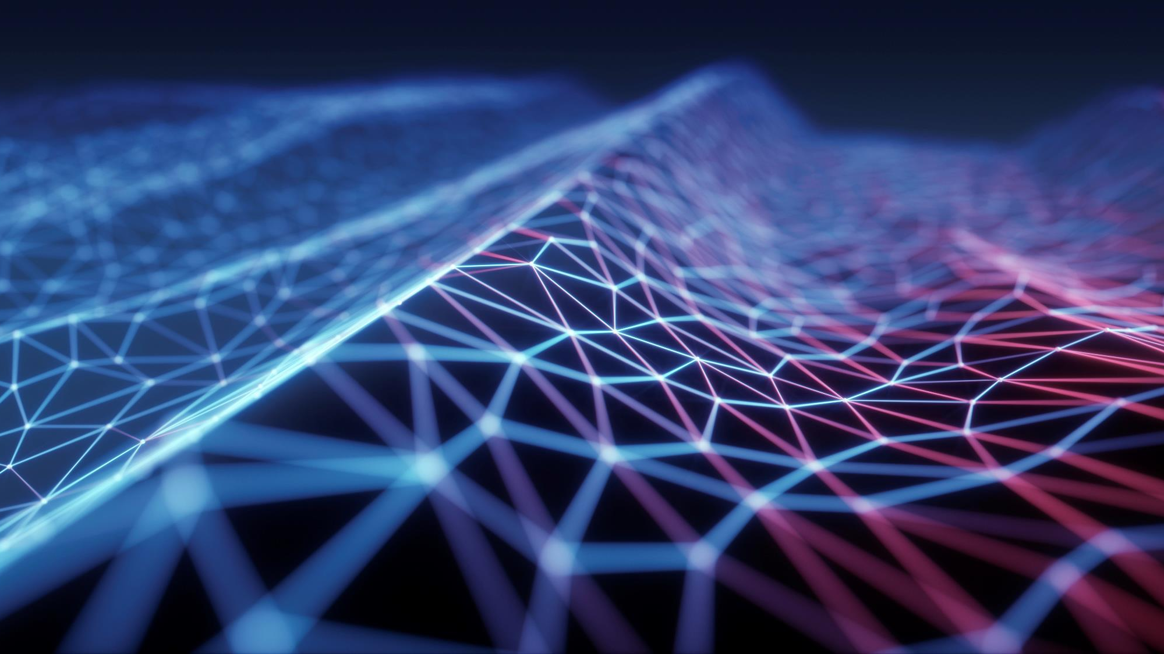
Synthetic data for Facial Recognition systems
Armaan khetarpaul

Slide 2
Topics
About
Towards Synthetic data
How to use Synthetic data
SOTA Results

Slide 3
About
What’s FR?
Need for synthetic data
Biases and Concerns

Slide 4
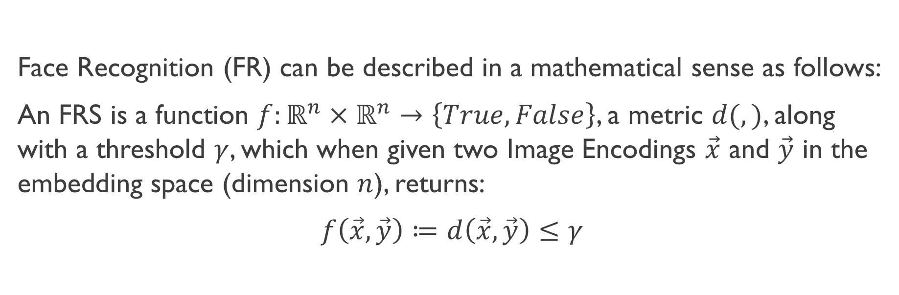
What’s FR?
Face Recognition (FR) can be described in a mathematical sense as follows:
An FRS is a function $f:ℝ^{n}×ℝ^{n}→\left\{True, False\right\}$, a metric $d(,)$, along with a threshold $γ$, which when given two Image Encodings $\vec{x}$ and $\vec{y}$ in the embedding space (dimension $n$), returns:
$f\left(\vec{x},\vec{y}\right)≔d\left(\vec{x},\vec{y}\right)≤γ$

Slide 5
SOTA FR Models
GhostFace
ElasticFace
ArcFace
CosFace
SphereFace
and more…

Slide 6







Need
The SOTA models are trained on web-scraped data, so as a result they give very less errors.
However, web-scraped data is heavily biased (in terms of race, lighting, make-up, etc.) and often contain label noise.
More importantly, the face images are collected without explicit consent, raising ethical concerns.
These models often fail to recognize/mis-recognize the minority class data.
Evaluation of FR Algorithms needs large amount of robust data.
Synthetic data can be used for morphing based attacks, Master face attacks, and Deep-fakes, for ethical uses.
They can be seen as a privacy-enhancing tool when they are used to avoid the illegal or unconsented processing of the data.

Slide 7
Biases and Concerns
Areas of bias:
Race:
Subject face images form the primary information source that encapsulates these race-related biological and physical differences, which are then combined with additional information, including gender, age, pose, facial expression and contextual aspects such as scene background, illumination, subject clothing and facial accessories such as glasses, facial hair, jewelry and makeup.
Skin tone:
Erroneous Skin Tone Annotation
Narrow Representation of Scales
Skin Tone as a Single Dimension of Race
Facial Phenotype:
A set of race-related facial phenotype attributes such as skin tone, nose shape, and lip shape are of primary interest

Slide 8
Biases and concerns
Data Acquisition issues:
Facial Imaging: Concerns about privacy, fairness, freedom and autonomy, and security.
Dataset Curation: Sampling processes are often affected by sampling bias, which significantly impacts racial bias in face recognition.
Capture Bias: Dataset imagery contains targets (faces) that have minimal spatial and illumination variation and can be related with pose bias within face recognition context, as there is still poor pose variance within datasets.

Slide 9
Biases and concerns
Category/Label Bias: Poses the ill-definition or mislabeling of subject identities and racial categories
Negative Set Bias: Target appearances that are not represented in the data set lead to recognition models that are overconfident and misrepresent performance by considering only a skewed subset of possible real-world data samples.
Face Localization: Corrupted data is more likely to cause face detection errors in specific demographic groups. Confounding factors including facial orientation, illumination, and resolution, can cause such disparate performance among demographic groups.

Slide 10
Biases and Concerns
Representation Concerns:
Choice of backbone architectures: DCNNs? ResNets?
Mutual Information Mitigation
Loss Function Based Mitigation
Domain Adaptation Based Mitigation

Slide 11
Biases and concerns
Other Concerns:
Disregard for privacy
Hard to collect data
Labeling may be bad
Collected data may not be sufficient for training

Slide 12
Towards synthetic data
What’s needed?
How to generate?
More features
Example datasets

Slide 13
Towards Synthetic data
All the above problems can be solved using synthetic data!
Trainable on small amount of data to produce infinite data
Reduced bias as synthetic bias can be added to cancel training data bias
Customisable for all scenarios
No privacy concerns
Ethical

Slide 14
What type of data is required?
Single faces of random identities
Multiple faces per random identity
Multiple faces of an existing identity
A face of multiple identities
A face of specific authentic identity

Slide 15
Generation of Synthetic data
Collection of some amount of real-world data.
Separate out features like baseline face model, skin textures, skin colors, phenotypes, hairstyle, accessories, etc.
A Face is sampled by randomly choosing a baseline face, and randomly sampling features to add to it, all sampled randomly from the training images.
All of this is done using a 3D mesh-point system. Models like 3DMMs, DCNNs are used for this process.
Even with a small amount of real data, billions of virtual data can be generated.

Slide 16
Generation of Synthetic data
To sampling prevent bias, an additional bias factor for a minority class can be added
For a diverse and hard dataset, the pitch, roll, and yaw angles are changed at the time of sampling to produce rotated faces
In such cases, image alignment and cropping is also performed to improve quality of dataset.
For some use cases, synthetic data is used alongside real data. This may create issues as the underlying distributions of both may not be same. Hence domain adaptation is performed.
To improve the data, a random lighting condition is also sampled from existing ones and applied to the image.
Furthermore, backgrounds can also be added to get a fairly realistic image of a human face.
Such models can also be used/trained to generate similar images of a given identity.

Slide 17
Some synthetically generated datasets
FaceSynthetics
USynthFace
DigiFace-1m
Idiff-Face

Slide 18
Some synthetically generated datasets
LFW
RFW
MS-Celeb-1M
IJB
VGGFace
CASIA-WebFace

Slide 19
How to use synthetic data?
Loss Functions
Adaptation
Characteristics Modification
Use with real data

Slide 20
Use with real data
Synthetic data can be used with real data in a few different ways:
Pure synthetic data
Synthetic mixed with real
Pre-training on synthetic data and fine-tuning on the real data.

Slide 21
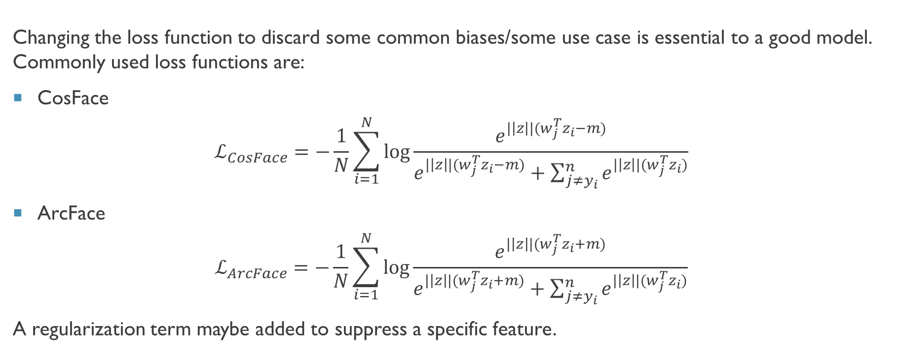
Loss Functions
Changing the loss function to discard some common biases/some use case is essential to a good model. Commonly used loss functions are:
CosFace
$$ℒ_{CosFace}=−\frac{1}{N}\sum_{i=1}^{N}{\log{\frac{e^{|\left|z\right||(w_{j}^{T}z_{i}−m)}}{e^{|\left|z\right||(w_{j}^{T}z_{i}−m)}+\sum_{j≠y_{i}}^{n}{e^{|\left|z\right||(w_{j}^{T}z_{i})}}}}}$$
ArcFace
$$ℒ_{ArcFace}=−\frac{1}{N}\sum_{i=1}^{N}{\log{\frac{e^{|\left|z\right||(w_{j}^{T}z_{i}+m)}}{e^{|\left|z\right||(w_{j}^{T}z_{i}+m)}+\sum_{j≠y_{i}}^{n}{e^{|\left|z\right||(w_{j}^{T}z_{i})}}}}}$$
A regularization term maybe added to suppress a specific feature.

Slide 22
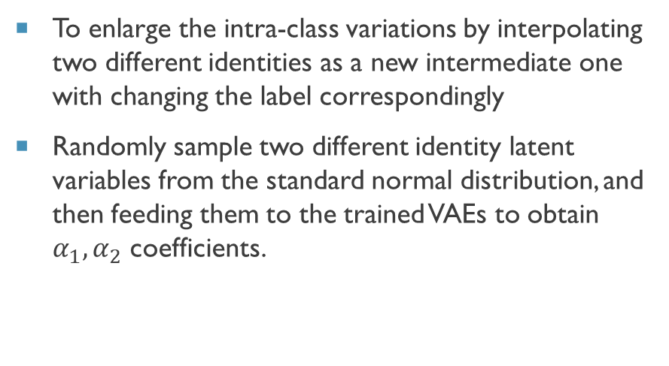
Adaptation
Identity Adaptation
Domain Adaptation
To enlarge the intra-class variations by interpolating two different identities as a new intermediate one with changing the label correspondingly
Randomly sample two different identity latent variables from the standard normal distribution, and then feeding them to the trained VAEs to obtain $α_{1},α_{2}$ coefficients.
Use of large-scale synthetic face images with a small number of real-world face images with labels as the training data.
When training, we perform adaptation within a mini-batch of synthetic images and a mini-batch of real images, where the labels changed accordingly as the supervision.

Slide 23
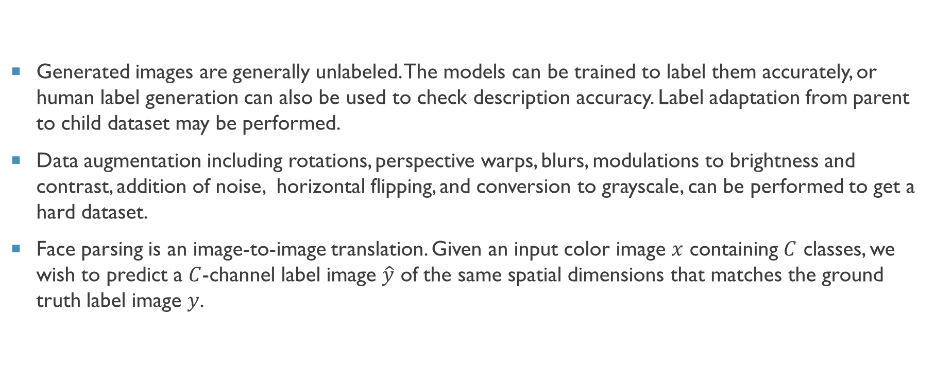
Characteristics Modification
Generated images are generally unlabeled. The models can be trained to label them accurately, or human label generation can also be used to check description accuracy. Label adaptation from parent to child dataset may be performed.
Data augmentation including rotations, perspective warps, blurs, modulations to brightness and contrast, addition of noise, horizontal flipping, and conversion to grayscale, can be performed to get a hard dataset.
Face parsing is an image-to-image translation. Given an input color image $x$ containing $C$ classes, we wish to predict a $C$-channel label image $\hat{y}$ of the same spatial dimensions that matches the ground truth label image $y$.

Slide 24
Characteristics Modification
Landmark localization is a technique finds the position of facial points of interest in 2D/3D.
Contextual Partial Dropout: If the network is overfitted to the identity-context condition, the generated images using the same identity context will be almost identical. Solved by dropping out components of a context embedding, each with a certain probability.
Balance between # IDs and # images/ID: Ensuring large number of IDs is important for learning diverse discriminative embedding. On the other hand, large number of images per ID (referred to as images/ID) is needed for learning robust embedding (that is not affected by the changes in pose, accessories, expressions, camera and environment).

Slide 25
SOTA RESULTS

Slide 26
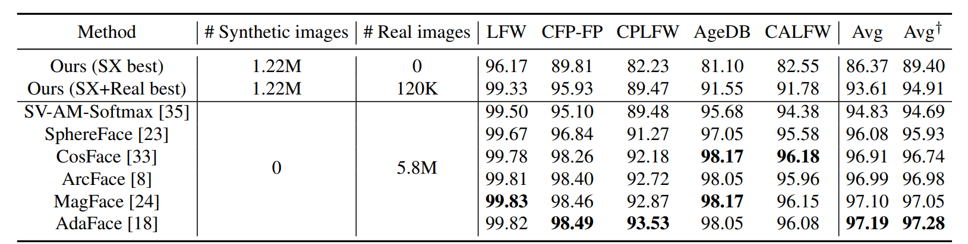
Results

Slide 27
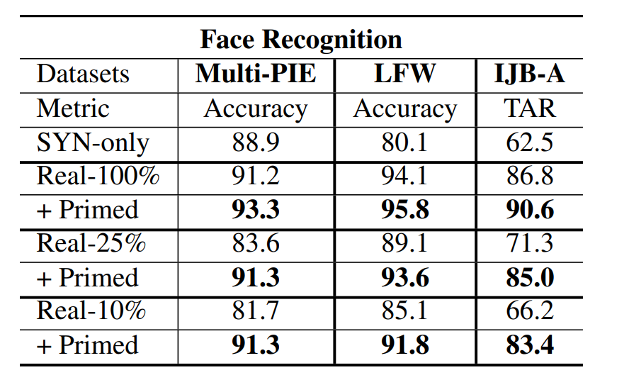
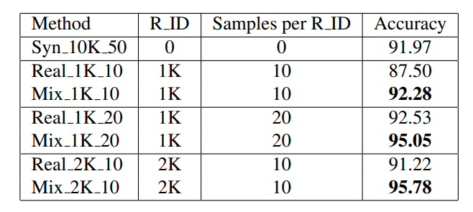
Results

Slide 28
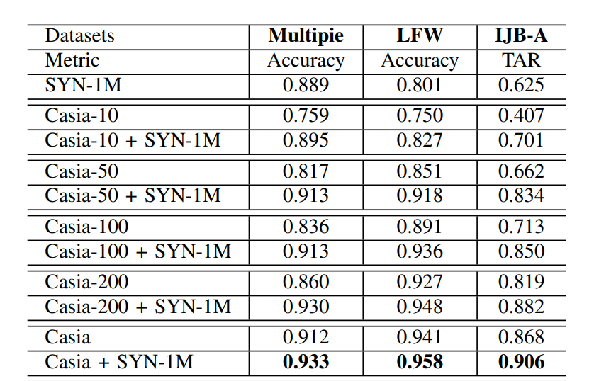
Results

Slide 29
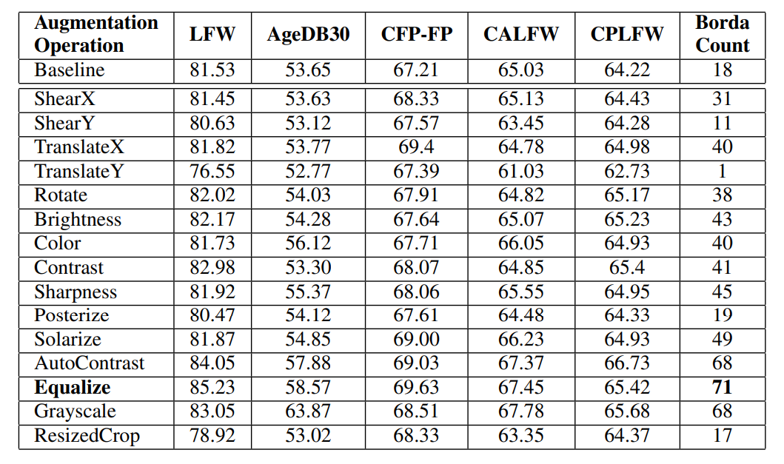
Results

Slide 30
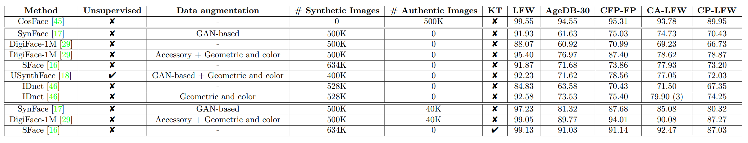
Results

Slide 31
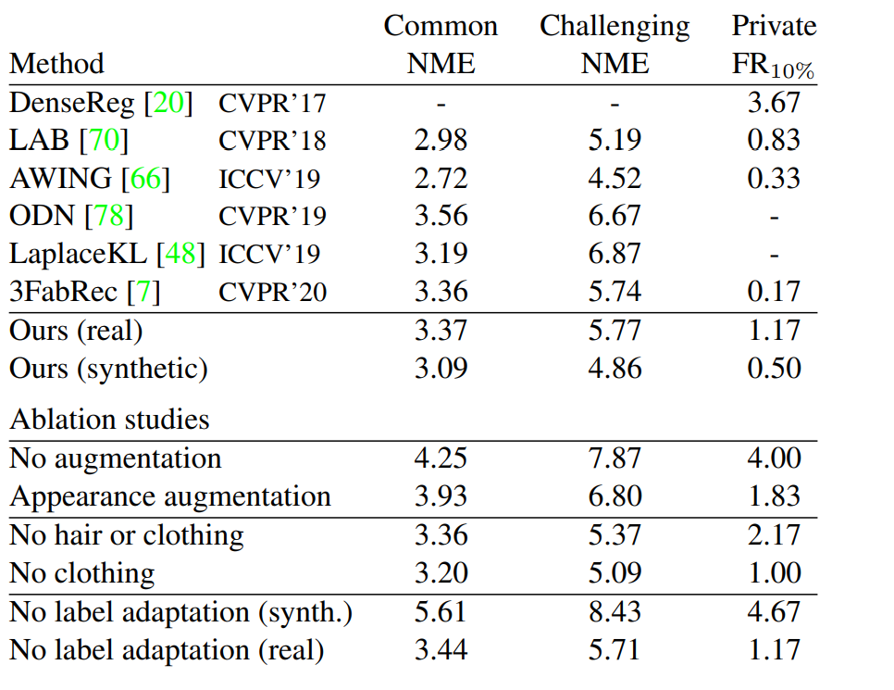
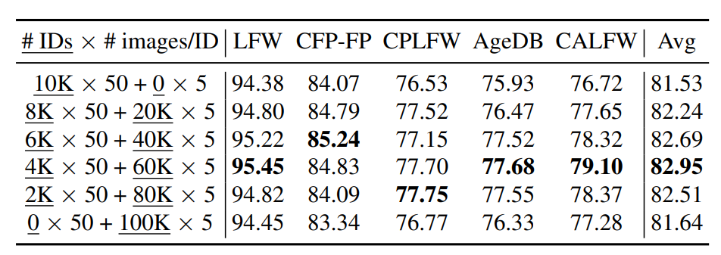
Results

Slide 32
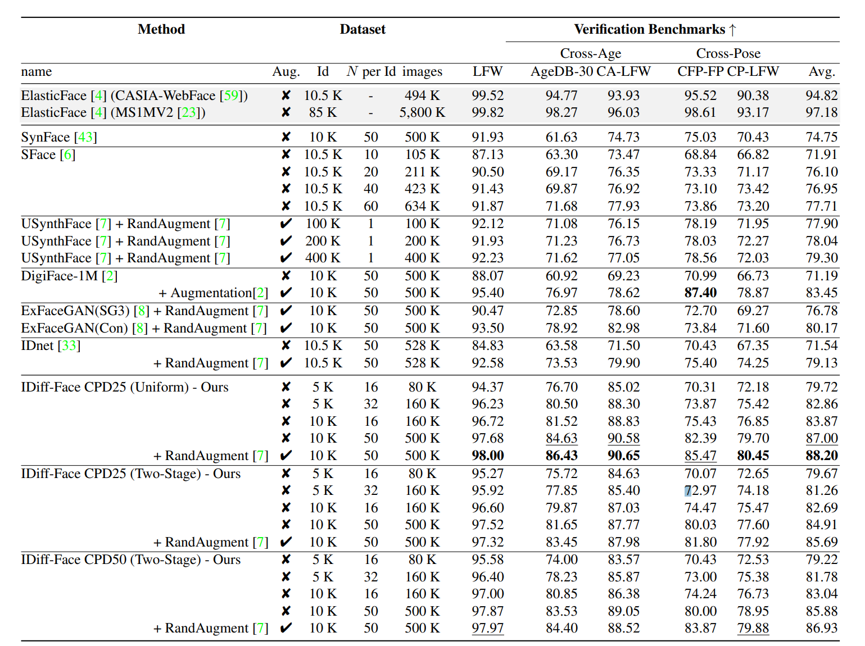
Results

Slide 33
The results show that use of synthetic data has a positive impact on accuracies!

Slide 34
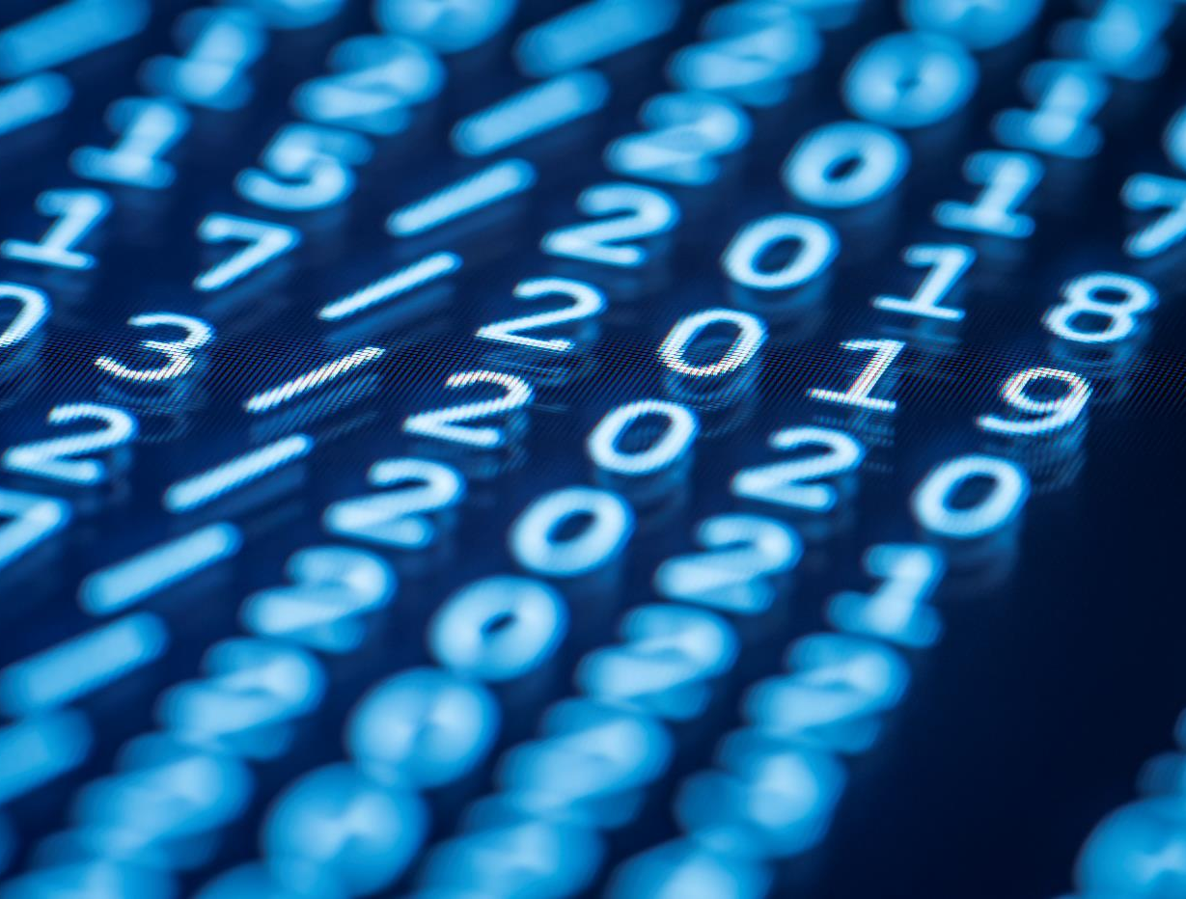
Thank You
"Synthetic data for face recognition: where every face is made up, but the accuracy isn't!"

